Slide 1

Racial Trauma and Its Impact on the Black Community
Dr. Jamila Holcomb
Licensed Marriage and Family Therapist

Slide 2
Agenda
Describe the current racial and mental health climate
Define racial trauma
Identify ways racial trauma can be experienced
Discuss the impacts of racial trauma
Explore healing practices
Consider organizational implications

Slide 3
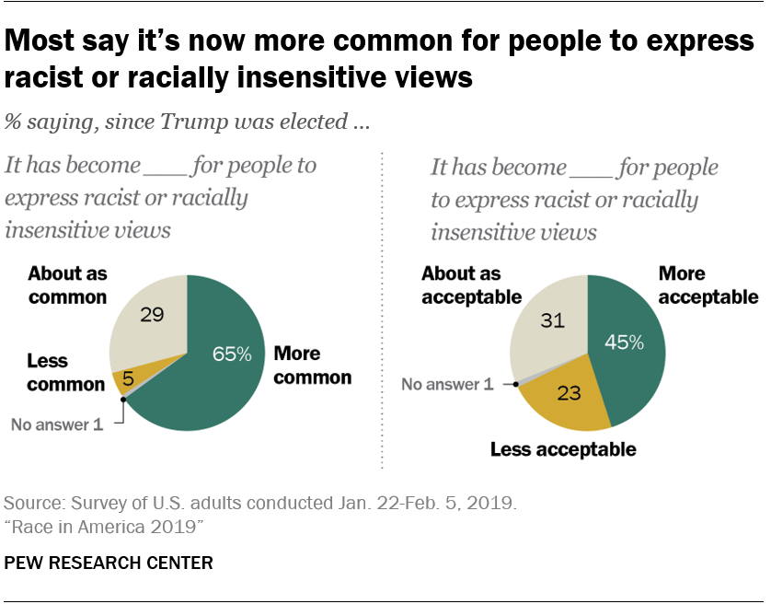
Current Racial Climate
Increased visibility of the violence and hate crimes
  By law enforcement and by civilians policing Black bodies
Increased frequency and acceptability
Notes:
Right now we are seeing increased visibility in the violence and hate crimes perpetrated against Black individuals. Both by law enforcement and by civilians policing Black bodies. In this study by the pew research center we see that majority of people believe that over the last few years it has become more common for people to express racist or racially insensitive ideas and a substantial number also believe that racism is now more acceptable.
What do you think? Has racism become more frequent and acceptable?

Slide 4
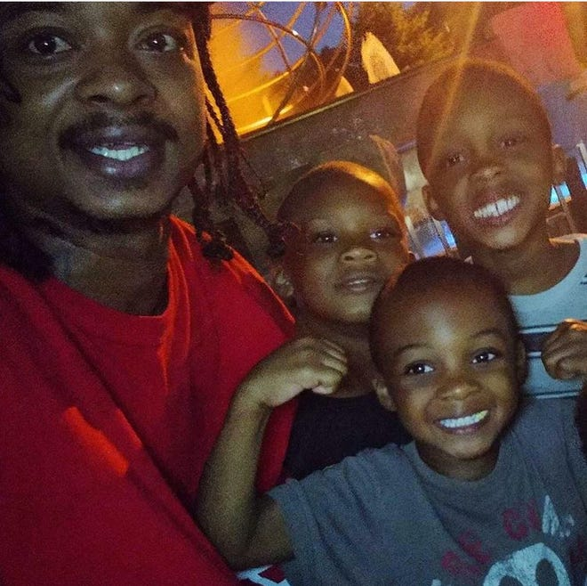




Current Racial Climate
Increased coverage in the media
  For better and for worse
  Jacob Blake, Rayshard Brooks, George Floyd, Breonna Taylor, Ahmaud Arbery…
Litke, 2020
Danner, 2020
Gold, 2020
BBC, 2020
CBS, 2020
Notes:
One of the reasons why we have increased visibility to these crimes is because there is increased coverage of this violence in the media. We can understand this increase in coverage as something that is for the better and for worse. On the one hand, the coverage is beneficial because we are becoming aware of the issue and we can begin to talk about it and face it, and identify solutions to solve it. The names of the victims become real, we can humanize them, we can fight for them, march, and protest for them.

Slide 5
Current Mental Health Concerns
Increased mental health concerns
  Anger
  Anxiety and Depression
  Helplessness
  Avoidance
  Fear and Distrust
Disparities in access to mental health services for Black Americans (NAMI)
Notes:
However, we also see that the increased coverage of the violence can have negative impacts both on our mental health, and on our ability to enact change. Because of the pervasive and ongoing nature of racism, it can overwhelm our capacities to cope, leaving us with feelings of anger, anxiety/depression, helplessness, and as a result we might engage in avoidance or dissociation to protect ourselves from experiencing these feelings.
Another important consideration of the current mental health concerns is that there are disparities in access to mental resources for Black Americans. So not only are Black Americans experiencing and witnessing this racial trauma, there’s just not a lot of resources available for them to properly process these experiences. The data from NAMI (national alliance on mental illness) reports that only 1/3 Black Americans who need mental health services actually receive it. So what we are seeing is that Black individuals are left to use their own individual coping strategies until we are hit with the next traumatic event, and then we see a pileup of stressors or a pile up of traumas. And that overtime has deleterious effects on mental and physical health, as we will get into.

Slide 6
What is Racial Trauma?
Racial trauma or race-based traumatic stress: the physical, emotional, and psychological pain associated with personally experiencing or witnessing racism/discrimination
  Similar impacts as experiencing other traumas
  Pervasive and multifaceted
  Co-occurs along with other traumas
Bryant-Davis & Ocampo, 2006 ; Carter, 2007; Comas-Diaz et al., 2019
Notes:
You are going to find that there are a lot of definitions of racial trauma that exist in the literature, and you may also see it referred to as race-based traumatic stress. In the most concise way possible, racial trauma is the physical, emotional, and psychological pain associated with experiencing or witnessing racism/discrimination.
The impacts of experiencing racial trauma are similar to experiencing other types of trauma (sexual or physical abuse). But what is unique and particularly detrimental about racial trauma is that it is pervasive and multifaceted, meaning that there is frequent exposure and re-exposure to race-based stress either directly or vicariously, and that the trauma can occur in a variety of forms. Further, racial trauma co-occurs with other traumas (i.e., community violence, personal victimization, global pandemics, combat, etc.), producing a mul-ti-plicative negative effect on the mental and physical health of Black trauma survivors.

Slide 7
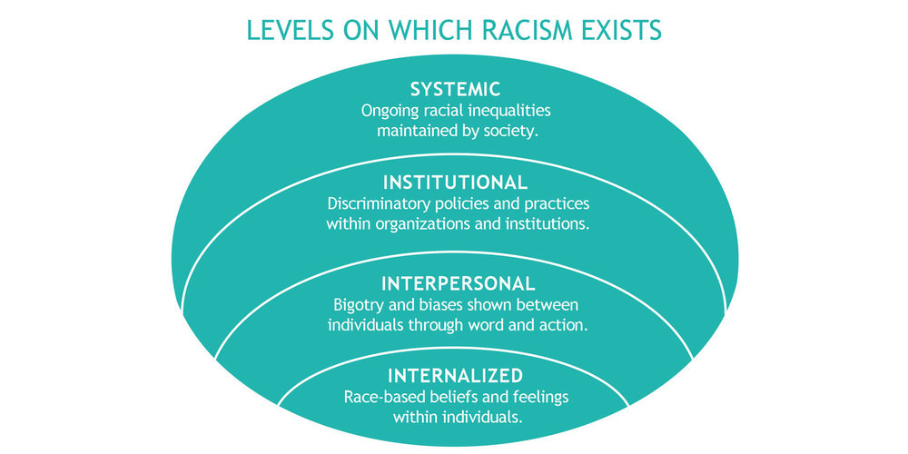
Ways Racial Trauma Can Be Experienced
Race-Related Life Events
Microaggressions
Vicarious Racism Experiences
Collective Racism-Related Stress
Systemic Racism
Historical Trauma
Lietz, 2018
(Harrell, 2000)
Notes:
There are various forms that racial trauma can occur in and here are just some of the ways that racial trauma can be experienced. (list them). These categories were identified by researchers over 20 years ago, and now scholars have now lumped these into 3 or 4 categories or levels as you see here, but I thought it was beneficial to parse these out for a more nuanced discussion.

Slide 8
Race-Related Life Events
Significant life events
Time limited; beginning and end
May lead to other events or the effects may be long lasting
Bloomberg, 2019
Refresh Financial, 2019
(Harrell, 2000)
Notes:
Race-related life events include significant life experiences that are traumatic but are relatively time-limited. So what I mean by that is that they typically have a beginning and end. Now, the experience may lead to other events, or the effects of that single experience may be long lasting. However, the experience itself has a beginning and an end.
Some examples of this include being rejected for a loan, for instance. So you go to apply for a loan and you are denied, while this event has a clear ending, not getting that loan may have long term implications for you and spiral into other negative events). Another example would be being targeted by the police. If you survive this encounter, the traumatic nature of this experience could stay with you for a significant amount of time. Unfortunately if you don’t survive this encounter, then the community experiences the trauma. So again, while these experience certainly are not isolated in their impacts, they would be considered one event in time.

Slide 9
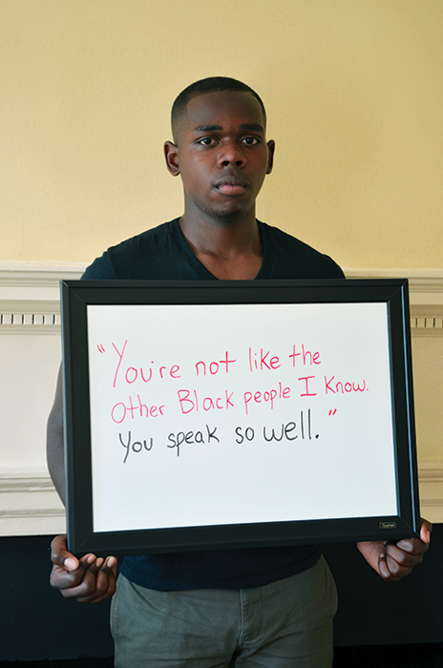
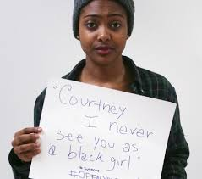
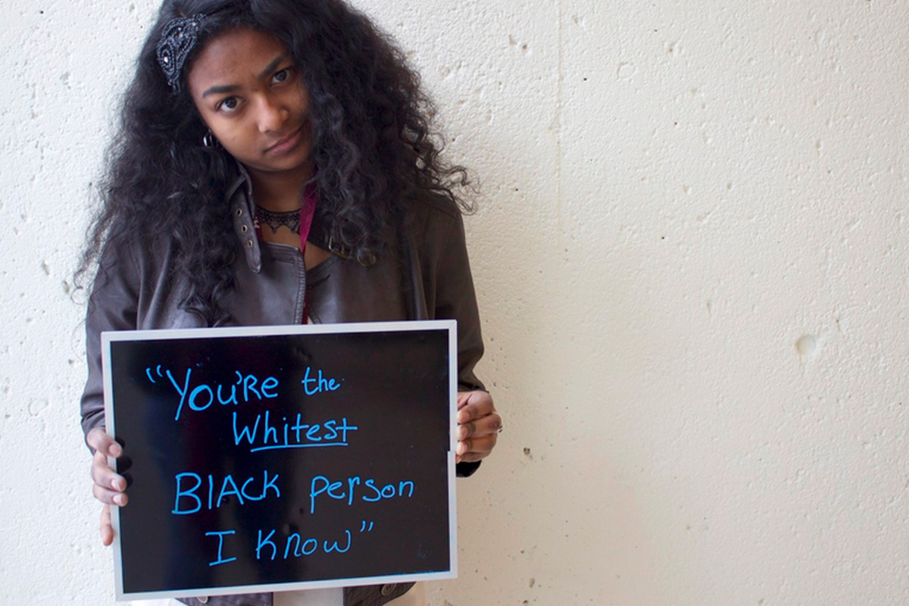
Microaggressions
Racial abuse (Kendi, 2019)
Daily reminders of your race being an ongoing stimulus
Dehumanizing, Demoralizing, Disrespectful, Objectifying
Nigatu, 2019
“I, Too, am Harvard” campaign, 2014
Brown University, 2014
(Harrell, 2000)
Notes:
Then we have microaggressions, or racial abuse as Kendi the author of How to be an Antiracist, prefers to call it, These are your daily reminders that your race/ethnicity is an ongoing stimulus in the world. The reason why I like the term racial abuse over microaggressions is because these events may seem small but that are dehumanizing, demoralizing, disrespectful, and objectifying. And we see microaggression in insensitive comments as represented in this pictures, or by jokes that are told in the office, being ignored or overlooked while waiting in line, being mistaken for someone who serves others (e.g., you are a guest at a hotel and you are mistaken for the maid, bellboy), being followed or observed while in public as we’ve seen an increase in lately, and a variety of other examples. Microaggressions are especially frustrating for the victims because they happen so frequently and sometimes subtly that it can be hard to know how to respond or when/if to respond. Because you might be encountering microaggression all day long, and this could be incredibly exhausting.

Slide 10
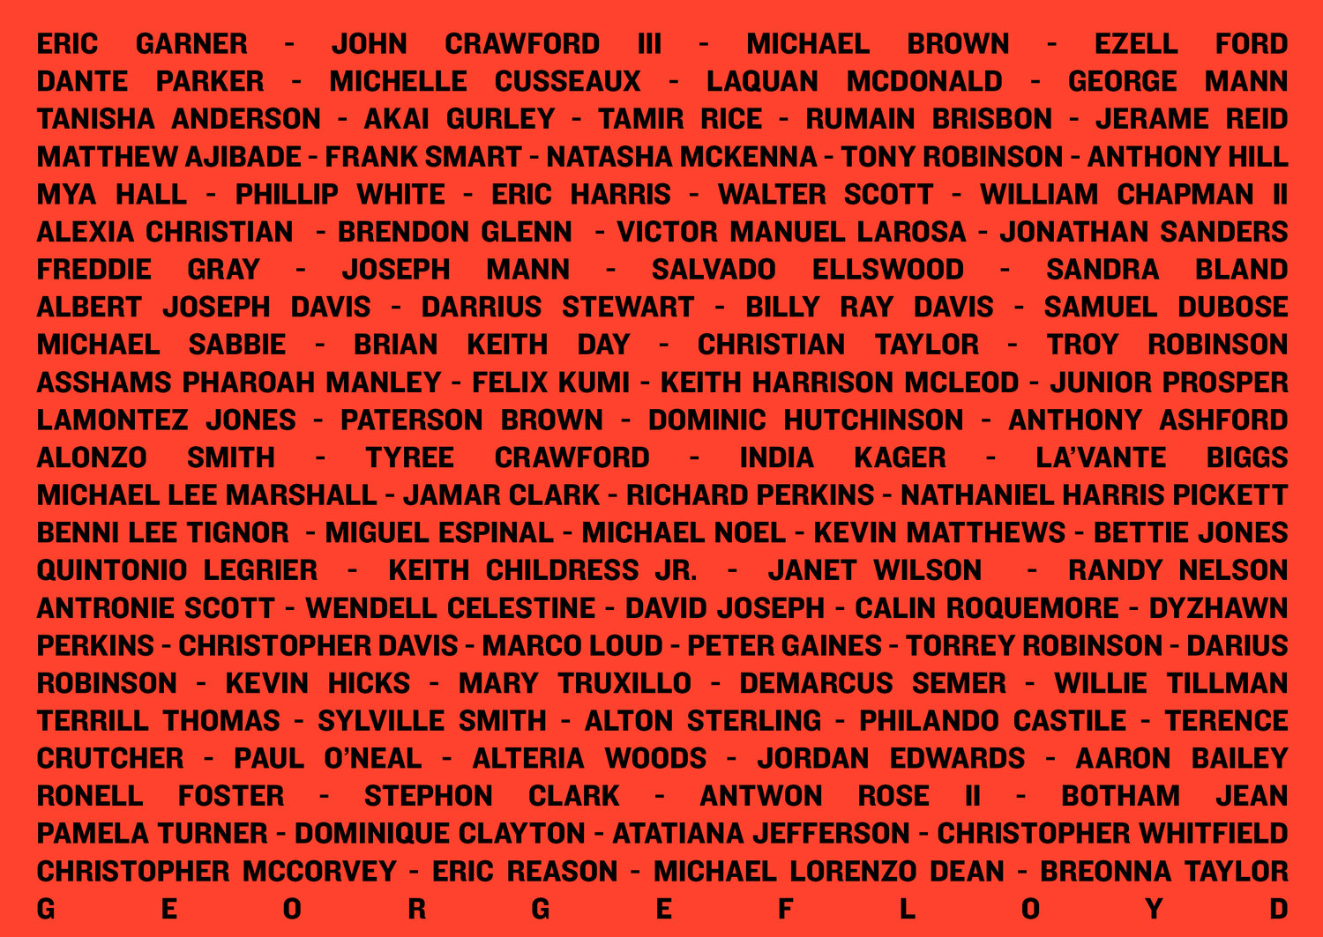
Vicarious Racism Experiences
Observing or hearing others experience
NPR, 2020
(Harrell, 2000)
Notes:
Vicarious racism is experiencing racism through observation and report. This can be from family and friends, or from the media as you see here with a noncomprehensive list of deaths at the hands of police since 2014 (NPR 2020). So hearing these stories or observing the traumatic experiences of others in the media, could result in vicarious trauma. What is particurlaly harmful regarfding vicarious racism is that you can experience racial trauma and the subsequent mental and physical health symptoms without actually personally being victimized. I think this is important for clinicians to be aware of, that simply hearing about a friend or family member, or seeing racism and violence in the media can in fact be experienced as racial trauma. I think sometimes these experiences can be overlooked or invalidated because it didn’t’ happen to you or you didn’t know that person on intimate level. But we know, that vicarious trauma is real and it should be acknowledge and validated.

Slide 11


Collective Racism Related Stress
Cultural-symbolic and sociopolitical manifestations of racism
Similar to vicarious trauma but not associated with an identifiable individual
New York Times, 2017
Wilde, 2020
CNN, 2018
(Harrell, 2000)
Notes:
Then we have collective racism-related stress. These are the cultural-symbolic and sociopolitical manifestations of racism that can be observed and experienced by Black individuals. These can present as stereotypic portrayals, lack of representation, or even negative representation of Black individuals. Being confronted with racist symbolism in ads such as this one from dove, or aunt jemima’s syrup label, or not seeing yourself represented in the group of interns at the White House, or seeing your community perceived as thugs, criminals, and villains in the media, all of these are potential stimuli for collective racism-related stress. These experiences can be distinguished from vicarious trauma in that they do not involve witnessing or hearing about a specific incident of racism associated with an identifiable individual, but rather represent perceived discrimination towards your racial group as a whole.
This type of race-related stress is often overlooked, but it’s extremely important. Because even on the off chance that someone has never experienced, witnessed, or heard about discrimination or racism experiences. Their well-being is STILL impacted by observing how racism affects the lives of others with whom they identify with and have a connection with. In the longer term this significantly impacts racial identity development, and studies have found that racial identity development has significant implications on our mental health.

Slide 12
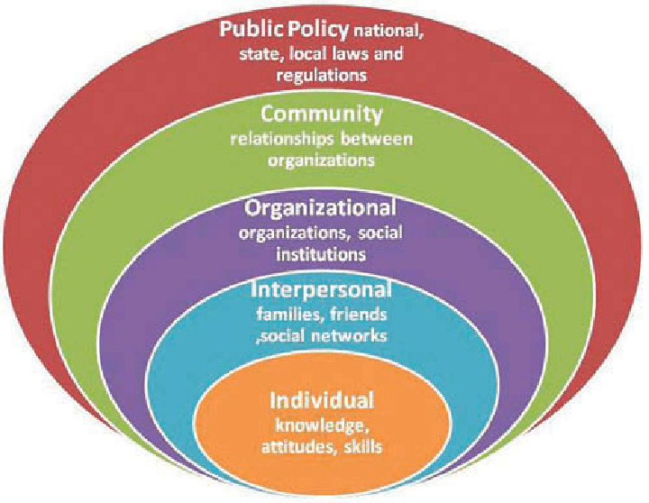
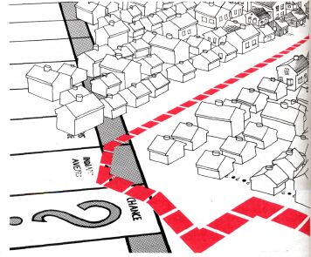
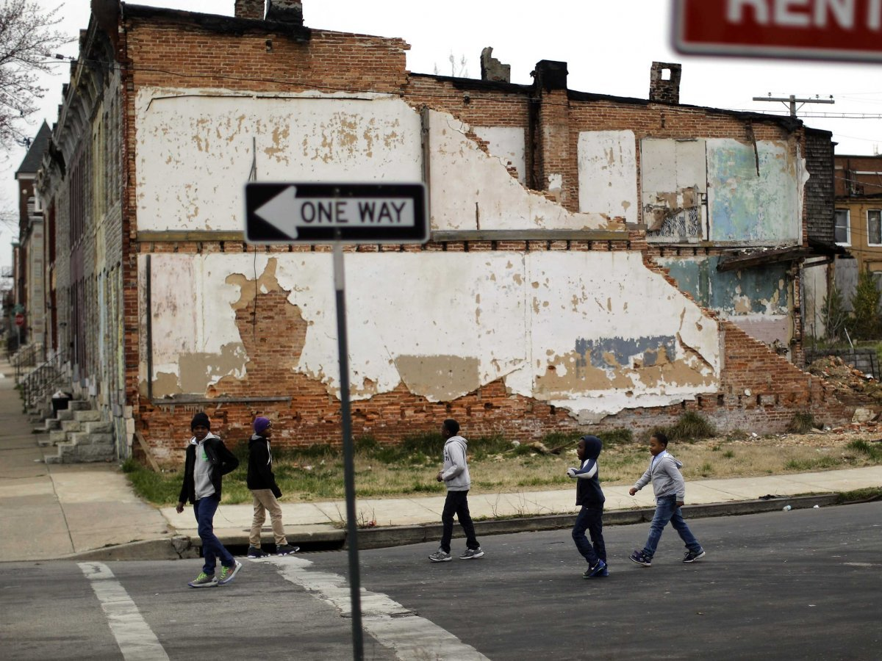
Systemic Racism
Racism imbedded in the social structure, political dynamics, institutions, organizations, etc.
Collins, 1979
Washington Informer, 2015
Ho, 2017
(Harrell, 2000)
Notes:
Now systemic racism, which is the buzz word of the year. This is the institutional racism that is imbedded in the social structure, political dynamics, within institutions, organizations, etc. We see this in a variety of forms, and its harder to identify this type of racism because it is so engrained in our cultural framework. But some examples would include the unequal distribution of resources and limitations on opportunities for advancement in Black communities, we see this through the history of redlining and housing discrimination, the unequal access to resources in Black neighborhood and schools, voter suppression, hiring polices, and so on.
Racism on this scale has a trickle down effect and impacts everything else. As you can see in this graph, if we have racism in the political and social structure it impacts racism that is perpetuated and experienced at every level in the system, which eventually we know impacts the individual. If we want to have larger scale changes then we cannot ignore systemic racism. We also know that the impacts are not one direction, but that the impact of racist attitudes, behaviors, and beliefs also travels from the individual and permeates the larger system. So change has to happen at all levels of the system.

Slide 13
Historical Trauma
The legacy of enslavement affects the current relationship between the descendants of the enslaved and descendants of enslavers
History also shapes the stories passed down through generations
(Harrell, 2000)
Vera, 2020
Notes:
Then lastly, we have historical trauma. The history of a racial group is impactful. The legacy of enslavement for instance affects the relationship between the descendants of the enslaved and the descendants of the enslavers. History also shapes the stories that are passed down through generations. And talking about the legacy of slavery, we know that those stories are very traumatic. We know that simply hearing about traumatic experiences, through vicarious trauma, is impactful, but with historical trauma you then internalize those stories as part of you and your family history. Dr. Joy Degruy (de-grew) developed a theory called posttraumatic slave syndrome which explores the ways in which slavery still has an impact on the Black community today.

Slide 14
Impact of Racial Trauma
Mental Health
  Lower self-esteem / perceptions of academic success or future success
  Greater depression, anxiety, aggression
  Intrusive thoughts, nightmares, hypervigilance, avoidance
  Numbness, Difficulty concentrating
  Narrowing sense of time
  Increased substance use and abuse
Physiological Health
  Somatic symptoms: migraines, nausea, body aches
  Hypertension, cardiovascular and respiratory concerns
Relational Concerns
  Distrust and fear
  Withdrawal
Bryant-Davis, 2007; Carter, 2007; Carter et al., 2017; Smith, 2010
Notes:
Now that you have a sense of the types of racial trauma, let’s get into how racial trauma impacts Black individuals. I want to say that these certainly are not all that could be experienced, and that everyone’s responses to racial trauma will be different, but here is an idea of what someone who has experienced racial trauma might be going through. So in regards to mental health (list), physical health (list), and one that is less recognized relational concerns. Withdrawing from relationships and social interactions, which we know has an impact on our overall health.
Many of these symptoms you might recognize mimic the criteria for PTSD. Several academic studies have made the connection between experiencing racial trauma and posttraumatic stress symptoms, with some suggesting that we should understand racial trauma as posttraumatic stress and others suggesting that we recognize it as something completely different. At any rate, many of us clinicians understand the significant impacts of posttraumatic stress, which at least gives us a good foundation for understanding how racial trauma impacts Black individuals.

Slide 15
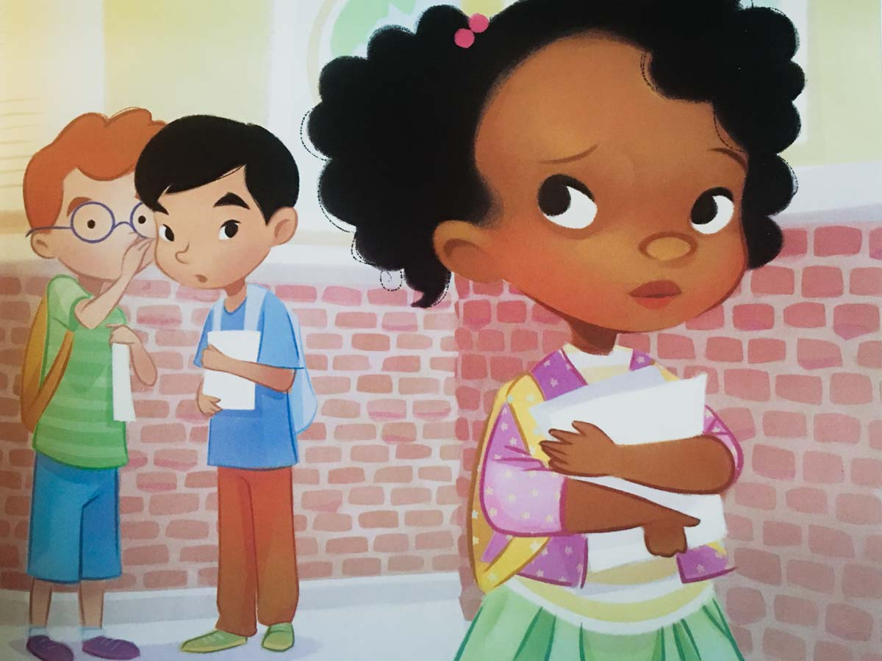
Impact of Racial Trauma on Children
Young Children (0-5)
  Minimal understanding
  Confusion
School Aged Children (6-11)
  Basic understanding
  Confusion; Hurt; Sadness; Anger
  Self-esteem
Adolescents and Young Adults (12+)
  More abstract understanding
  Impacts on Identity Development
  Outlook for the future
Illustration from ‘Not Quite Snow White’ by Franklin and Glenn
Notes:
Which brings me to talking about racial trauma impacts children. In addition to the mental health concerns that I already talked about, racial trauma will impact children different depending on their developmental stage. In the first couple of years of life children are too young to understand the complexities of racism, however they are not too young to display bias. Studies have show that children as young as 6 months old will display preferences for people of a certain race, and at 2 years old can categorize people by race and display bias in their play. This could look like kids pointing out differences in your skin color, and hair texture, and perhaps children of the same race/ethnicity grouping in their play. At this young age, if children experience racism or discrimination, they are likely to feel confused and not understand why their peers do not want to play with them.
Once kids reach school age they have more basic understanding of racial categories. If they experience racism at this age, it is likely to be more clear to them what is happening. They may experience comments such as “I can’t play with you because you are black” or experience differential treatment by a teacher. They are still going to be confused, but this might also be accompanied by hurt, sadness, anger, and even begin to impact their self-esteem.
As children reach adolescence and young adulthood they acquire more abstract thinking skills which allows them to further understand the complexities of racism. During this age kids are working to understand their race and are beginning to form their racial identity. So experiences of racism and discrimination will begin to impact this identity development process and their outlooks on their future.

Slide 16
Healing Options for Racial Trauma
Viewing racial trauma from a trauma-informed lens
  Breaking down the trauma experience to two phases
Arousal Phase
  Our nervous system is overwhelmed
  Fight/flight
  Narrowing sense of time
Recovery Phase
  Resiliency and Strength
  Poor recovery that impact coping
(Smith, 2010)
Notes:
Viewing racial trauma from a trauma-informed lens
Arousal – nervous system is overwhelmed as they are attempting to respond and manage the threat
Trauma typically keeps us stuck in the past
Impacts our ability to feel safe in the present
Future is blocked

Slide 17
Healing Options for Racial Trauma
Healing practices that are effective:
  Do not pathologize
  Create opportunities for individuals to tell their stories and to process
  Teach yoga, martial arts, meditations, diaphragmatic breathing, and other forms of emotional self-regulation that are regularly practiced
  Empower individuals to have control
  Use successful survivors of trauma to guide others
  Teach about trauma and its impacts
  Use recovery group experiences
  Provide opportunities to reprocess new experiences of trauma
(Smith, 2010)
Notes:
healing practices that are effective for addressing trauma
These can easily fit in with the work of your center. Helping Black individuals to process and manage their reactivity when they are in the arousal phase, and then help them to process cope, and reprocess the experience in a healthy way as they recover

Slide 18
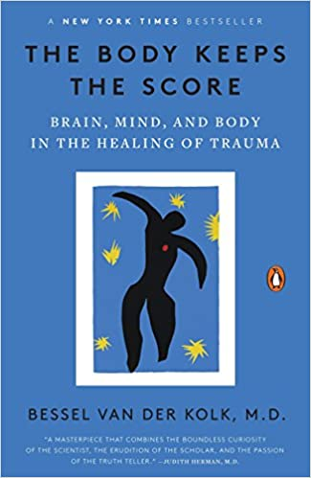
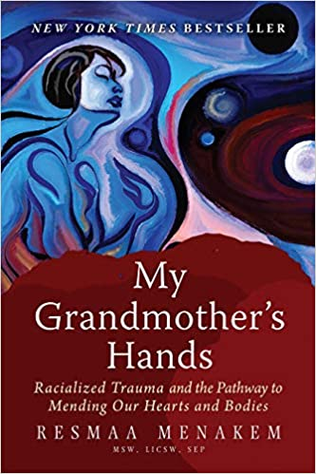
Organizational Considerations
Affirm and Acknowledge the wide-reaching impacts of racism
“Realization of Chan is the direct personal awakening to the interconnectedness and dynamics of life”
Notes:
organizations have the responsibility of affirming and acknowledging the wide-reaching impacts of racism and how your organization and its members are not immune from participating in and benefiting from the racist structure. You are doing this through your educational series. As I am learning more about your center and the practice of Chan, your website says this (read). We become aware of the interconnectedness of humanity, and our suffering, particularly under white supremacy. I would encourage anyone who is interested to also read these two books

Slide 19
Organizational Considerations
Challenge staff and students with opportunities for growth
  Explore racial identity and racial belief systems
  Confront and work through biases
  Facilitate race conversations
“The teaching starts with facing the self, accepting the self, maturing the self, and eventually letting go of the self, which is awakening of wisdom and compassion that leads to harmony, peace, and compassion for the world”

Slide 20
Organizational Considerations
Assess your racial climate
  Gather data on current representation at all levels of your organization (students, meditation teachers, staff, etc.)
  Assess current environment and safety
Research what is currently available for Black students
  Liberate App
  Black Lives Matter Guided Meditation for Healing Racial Justice
  The Ally + Accomplice Meditation for Cultivating an Anti-Racist Mindset
Go to and learn from the Black community
Notes:
Before we begin inviting Black students to your center, its important too make sure that the climate is safe. Gathering current data on how many black individuals are currently employed at all levels in your organization. Assessing the current feelings of safety within your establishment by disseminating confidential surveys. These surveys should include questions both about interpersonal interactions but also how safe and inclusive the environment felt.
Then research what is currently available for Black students of meditation and see what is working well. No need to reinvent the wheel

Slide 21
Thank you!
Any Questions?
Contact information
holcombcounselingandconsulting@gmail.com
www.holcombcounselingandconsulting.com

